Slide 1









AlignVLM: Bridging Vision and Language Latent Spaces for Multimodal Document Understanding NeurIPS 2025
Ahmed Masry, Juan A. Rodriguez, Tianyu Zhang, Suyuchen Wang, Chao Wang, Aarash Feizi, Akshay Kalkunte Suresh, Abhay Puri, Xiangru Jian, Pierre-André Noël, Sathwik Tejaswi Madhusudhan, Marco Pedersoli, Bang Liu, Nicolas Chapados, Yoshua Bengio, Enamul Hoque, Christopher Pal, Issam H. Laradji, David Vazquez, Perouz Taslakian, Spandana Gella, Sai Rajeswar

Slide 2
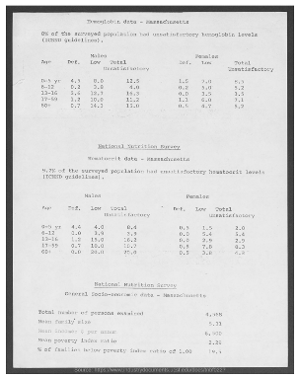
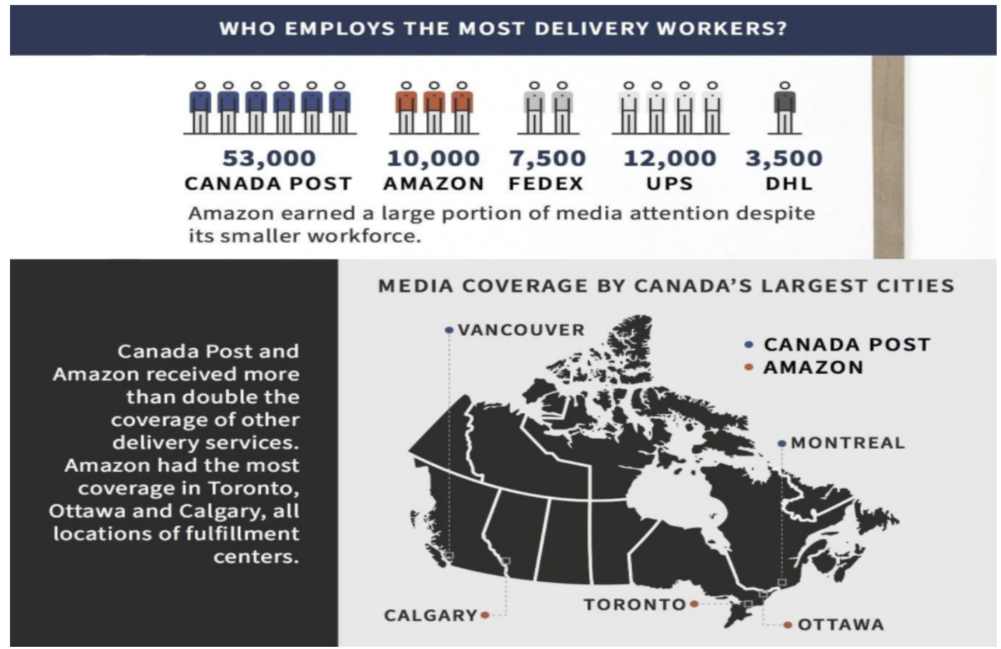
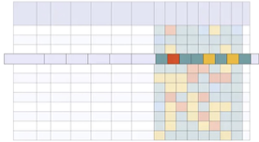
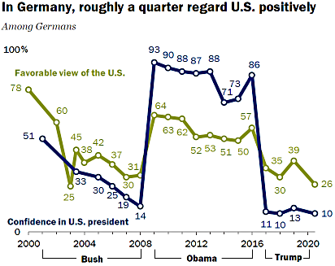
(5) AlignVLM: Motivation
Text-rich Visual Understanding: Essential for tasks in enterprise such as document understanding, trends analysis, table extraction where both language and visuals are critical.
PDF Analysis
Infographics & Charts
Table Extraction
This chart …..
LLM
Vision Language Models (VLMs) typically consist of three components:
Vision Encoder, pretrained on images.
LLM, pretrained on text
Connector that maps visual features into the LLM’s text space.
Connector
Tokenizer
Summarize the chart
Vision Encoder

Slide 3
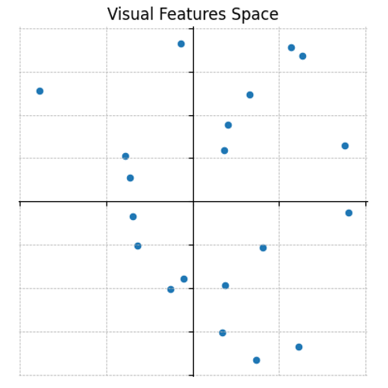
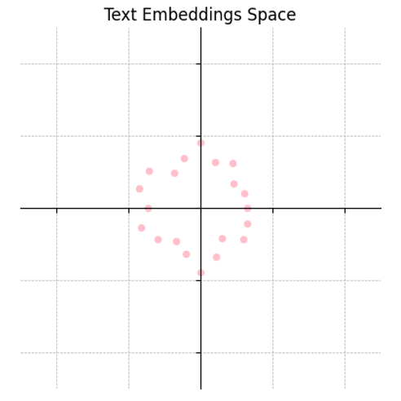

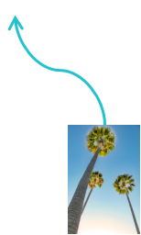
(5) AlignVLM: Motivation
LLM is pretrained to process a discrete set of text embeddings
Existing connector (e.g., MLP) produce continuous visual features
Out-of-distribution (OOD): making the connector data hungry!
Unconstrained Mapping: They do not enforce any hard constraints which makes them prone to noise.
This chart …..
LLM
Connector
Tokenizer
Summarize the chart
Vision Encoder
Text Embeddings
Can we exploit the LLM’s inductive bias by aligning visual features directly with text embeddings?

Slide 4
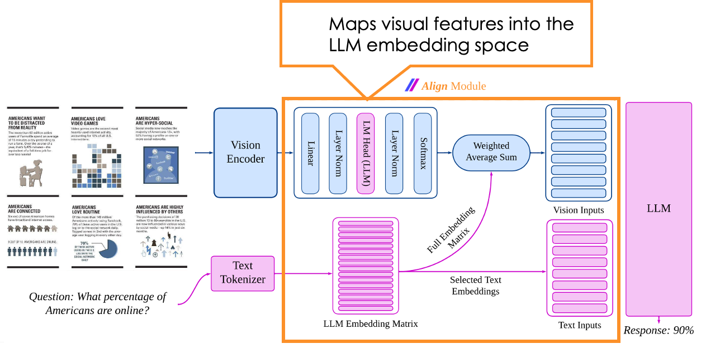


(5) AlignVLM: Architecture
Map visual features to a distribution over LLM token embeddings.
Computes final features as a weighted average of text embeddings.
Constrains visual inputs to the convex hull of the LLM’s embedding space, making them familiar to the LLM.

Slide 5
(5) AlignVLM: Training Setup
Training Stages
Stage 1: Natural Image Understanding
Data: CC-12M (Image-Caption)
Stage 2: Document Understanding Data: BigDocs-7.5M
Stage 3: Instruction Tuning for downstream tasks
Data: BigDocs-Docdownstream
Model components
Evaluation Benchmarks
LLM: Llama 3.2 Family (1B, 3B, 8B)
Vision Encoder: SigLip-400m
Nine document benchmarks, including:
DocVQA, InfoVQA, ChartQA, TableVQA, etc.

Slide 6
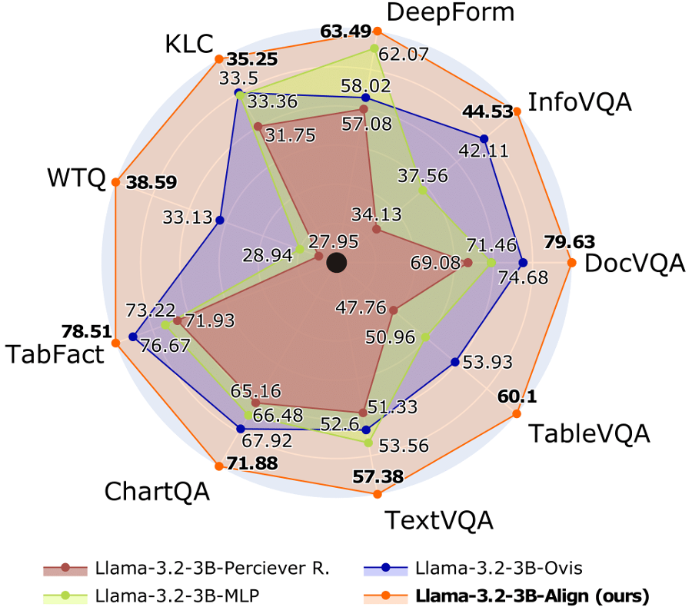
(5) AlignVLM: Results
We compare our Align Module against common connectors:
MLP, Perceiver Resampler, Ovis
Trained under similar configurations to ensure a fair comparison.
The Align Module outperforms them all and achieves better accuracy on diverse document understanding tasks.

Slide 7
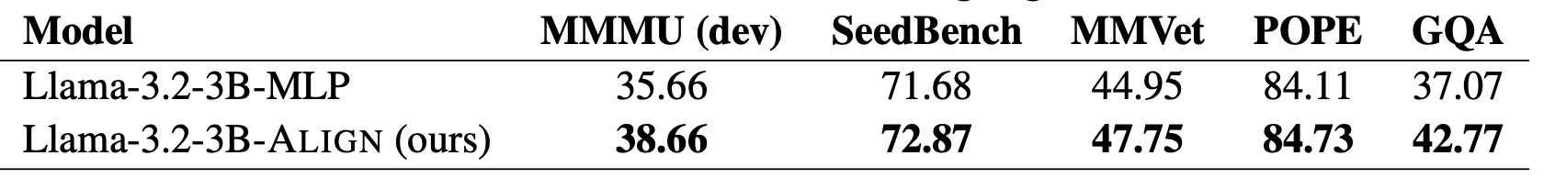
(5) AlignVLM: General Vision Tasks
Stage 1: Natural Image Understanding
Data: CC-12M (Image-Caption)
Stage 2: Instruction Tuning Data: Mammoth-vl-12M

Slide 8
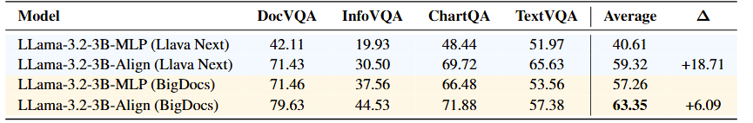
(5) AlignVLM: Low Resource Setup
Stage 1: Natural Image Understanding
Data: Llava-585K (Image-Caption)
Stage 2: Instruction Tuning Data: Llava-Next-779K

Slide 9
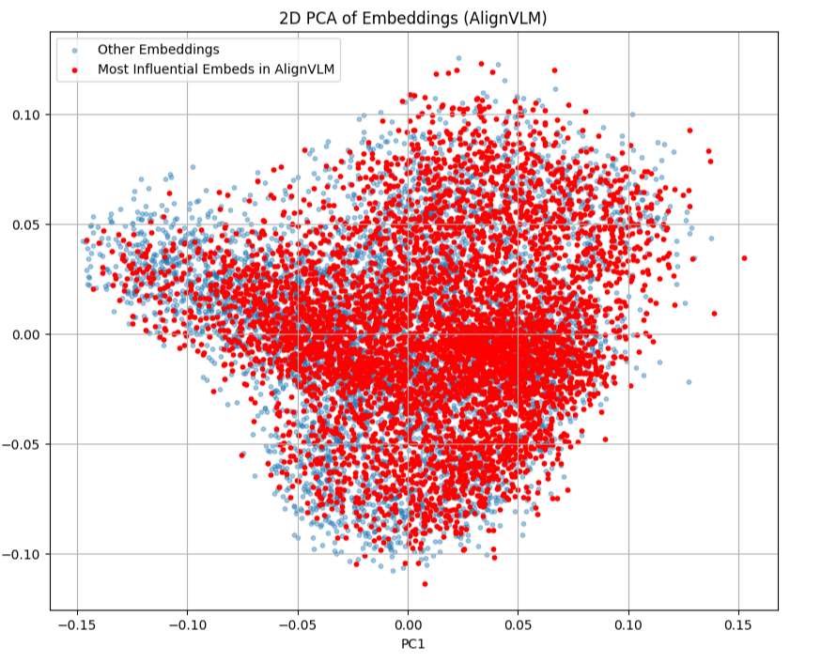
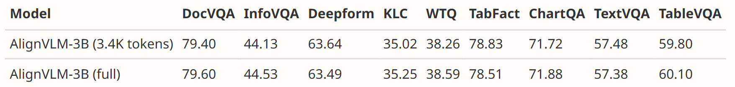
(5) AlignVLM: Pruning
Token utilization: Align focuses on ~3.4K out of 128K tokens, ignoring the rest.
Latent coverage: These tokens span the LLM’s embedding space.
Efficiency: Pruning to these tokens preserves performance and boosts efficiency.

